Slide 1
Classes
Lecture # 14
Polymorphism

Slide 2
Polymorphism
The word polymorphism means having many forms.
Typically, polymorphism occurs when there is a hierarchy of classes and they are related by inheritance.
C++ polymorphism means that a call to a member function will cause a different function to be executed depending on the type of object that invokes the function.

Slide 3
Real life example of polymorphism, a person at the same time can have different characteristic.
Like a man at the same time is a father, a husband, an employee.
So the same person posses different behavior in different situations.
This is called polymorphism.

Slide 4
Types
Mainly divided into two types:
Compile time Polymorphism
Runtime Polymorphism

Slide 5
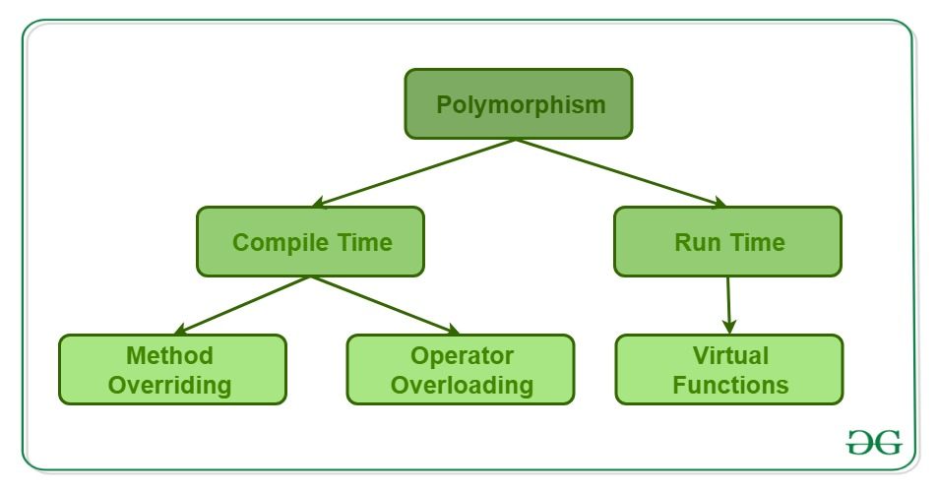

Slide 6
Compile Time Polymorphism
This type of polymorphism is achieved by:
Function overloading or function Overriding
Operator overloading.
This is also known as static (or early) binding.

Slide 7
Function Overloading
When there are multiple functions with same name but different parameters then these functions are said to be overloaded.
Functions can be overloaded by change in number of arguments or/and change in type of arguments.

Slide 8
Based on how many parameters we pass during function call determines which function is to be called.
In different conditions the output is different.
Since, the call is determined during compile time that’s why it is called compile time polymorphism.

Slide 9
Function Overriding
Function overriding occurs when a derived class has a definition for one of the member functions of the base class.
That base function is said to be overridden.

Slide 10
When child class declares a method, which is already present in the parent class then this is called function overriding
The child class overrides the parent class.
In case of function overriding we have two definitions of the same function, one is parent class and one in child class.
The call to the function is determined at runtime to decide which definition of the function is to be called.
That’s the reason it is called runtime polymorphism.

Slide 11
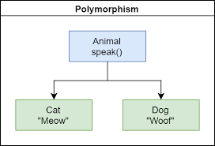

Slide 12
Runtime Polymorphism
This type of polymorphism is achieved by Function Overriding using virtual functions.
This is also known as dynamic (or late) binding.

Slide 13
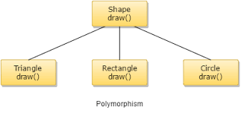

Slide 14
Quiz
Write a C++ program that has a parent class ‘Shape’ with parameters length and width and a function Area().
The class Shape has further subclasses ‘Rectangle’ and ’Square’.
Find the area for each of the derived class object and Parent object.

Slide 15
References
https://www.geeksforgeeks.org/polymorphism-in-c/
https://www.tutorialspoint.com/cplusplus/cpp_polymorphism.htm
https://www.w3schools.com/cpp/cpp_polymorphism.asp
https://www.geeksforgeeks.org/virtual-functions-and-runtime-polymorphism-in-c-set-1-introduction/

